Slide 1
Contact Localization Using T1 MRI and CT Imaging
Adam Li
3/28/19

Slide 2
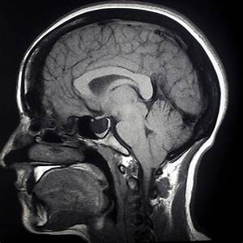
Background – Datasets
MRI
CT
Rawdata (.dicoms)
Processed Data

Slide 3
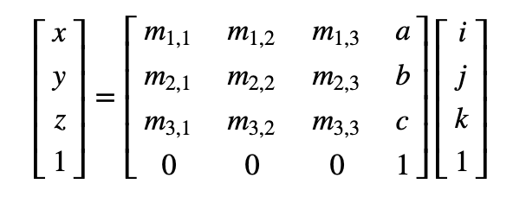
Background – Affine Transformations and Coordinate Space

Slide 4
Background – Pipeline Steps
Reconstruction
Coregistration
Contact-Localization

Slide 5
Background - Reconstruction
Atlases:
Montreal Neurological Inst (MNI)
Desikan-Killiany (DK)
Destrieux
Talairach
Etc.

Slide 6
Background - Coregistration

Slide 7
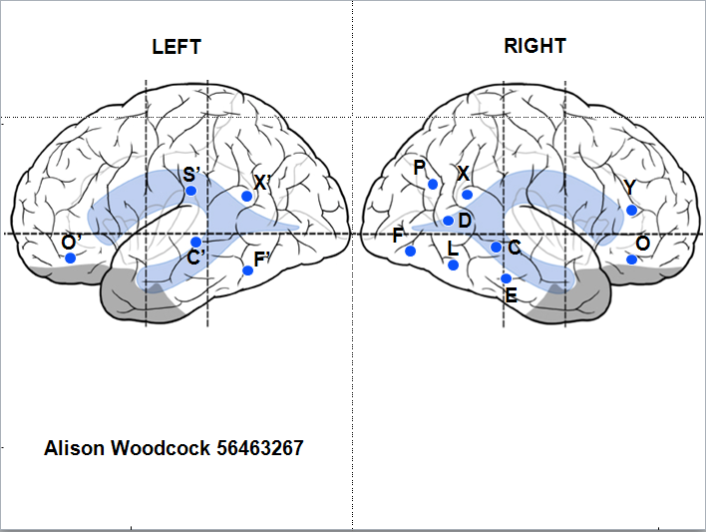
Background – Contact Localization

Slide 8
FieldTripToolbox

Slide 9
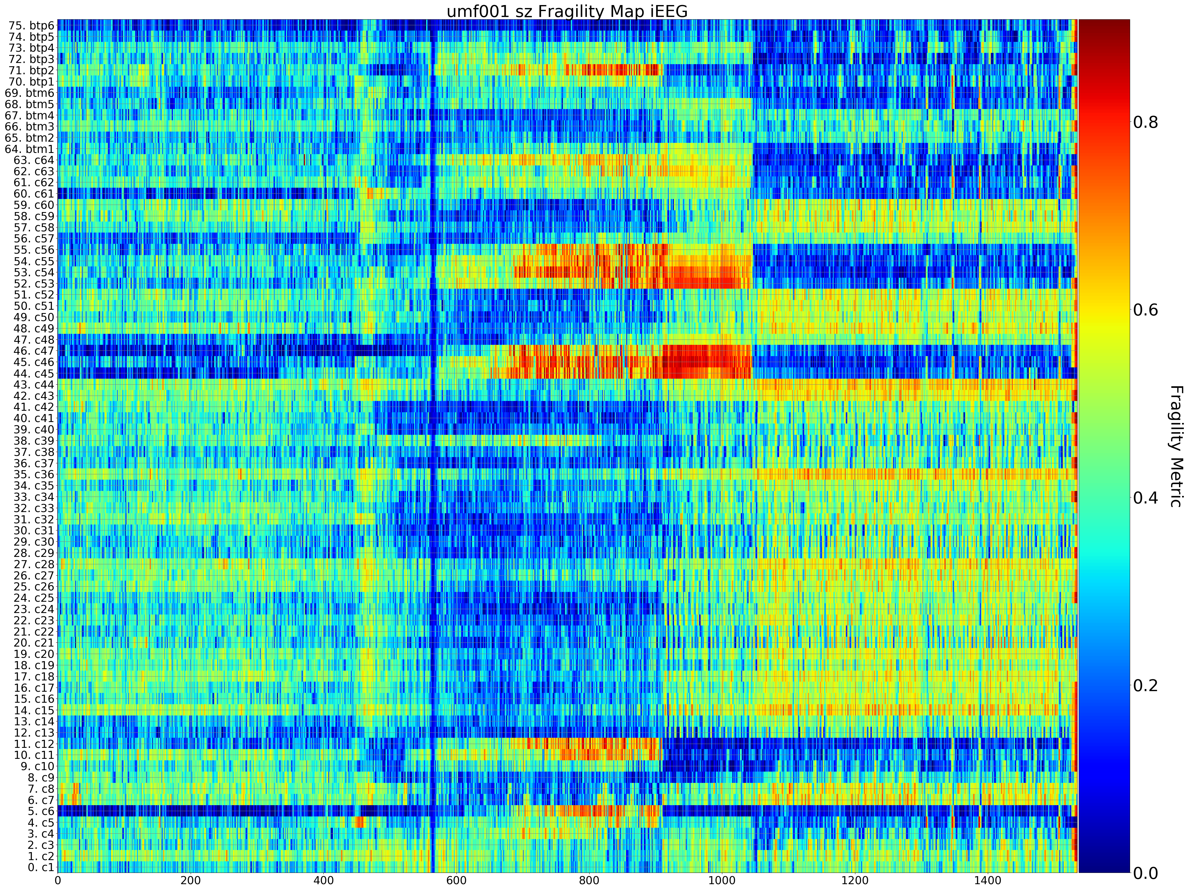
Example Spatiotemporal-Anatomical Analysis - UMF001
Clinical Category: 2
Engel Score: 1
Outcome: S
Age: 37
Gender: F
Treatment: R Anterior Temporal Lobe
2 Grids of 32 contacts located Right frontal and right temporal; 2 strips covering basta temporal strctures (1X6) towarda head and tail of hippocampus

Slide 10
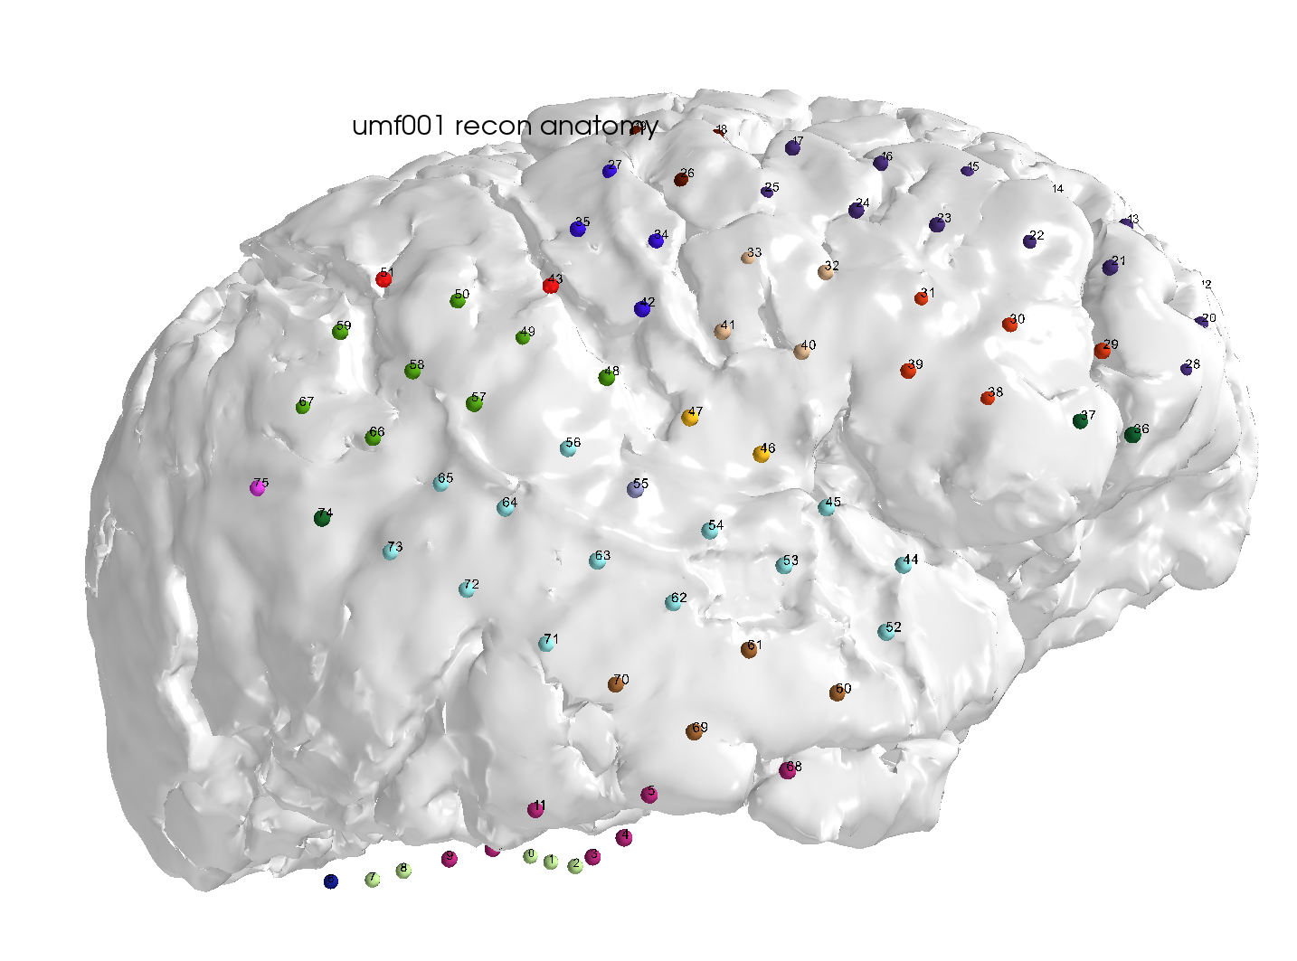
Example Spatiotemporal-Anatomical Analysis - Annotated Via Atlas
Temporal Lobe Labels
Btm1-6
Btp1-6
C33-34, c41-45, c49-64

Slide 12
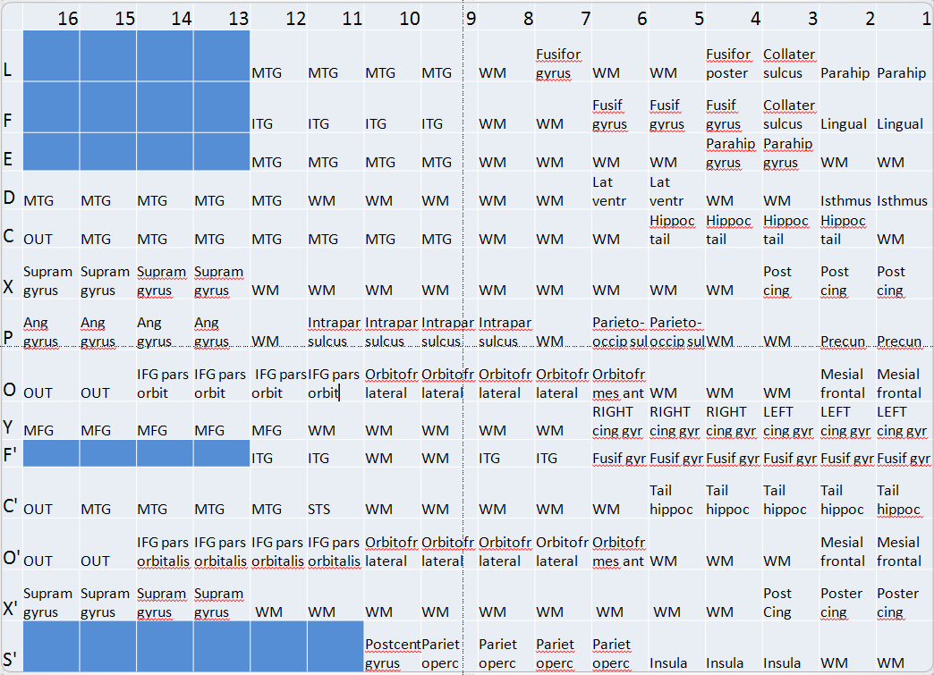

Slide 13
References

